Slide 1

Adult income prediction
-Technical Analysis

Slide 2
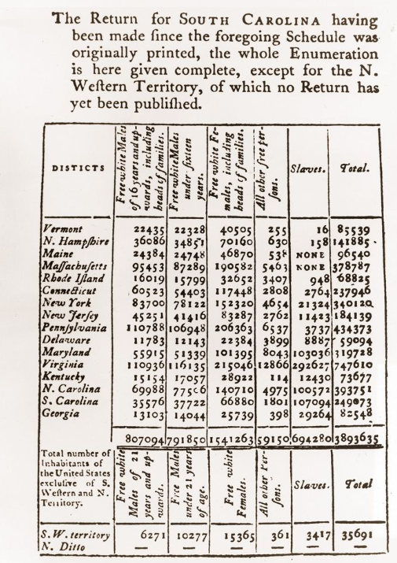
For the first Census, 650 men on horseback were dispatched to go door-to-door around the original 13 states. The overall cost in 1790 was $45,000.

Slide 3



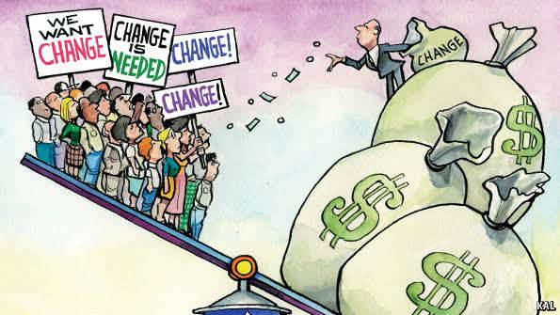
Introduction
Income inequality has long been a significant problem in the U.S., with a large percentage of wealth going to a small percentage of the population.
Income inequality has been correlated with…
Higher levels of crime
Stress
Mental illness

Slide 4


Problem Statement
This study aims to show the usage of machine learning techniques to address the income equality problem.
Classification has been done to predict whether a person’s yearly income is US falls in the income category of
Either grater than 50K Dollars
Or Less-Equal to 50K Dollars
Based on other attributes.

Slide 5

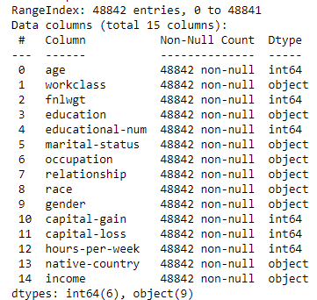
What our dataset contains
Kaggle Dataset
48,842 Records
42 Countries
14 Attributes
Income – Target column

Slide 6
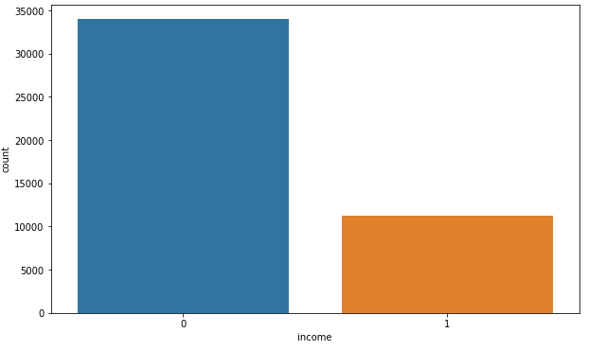
Data Assessment
45, 222 Records
34,000 people
<=50K
11,000 people
>50K

Slide 7
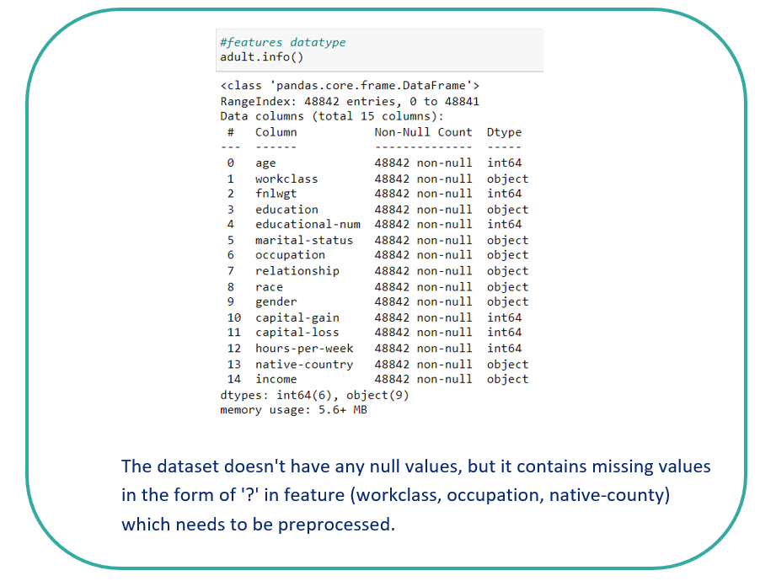

Slide 8
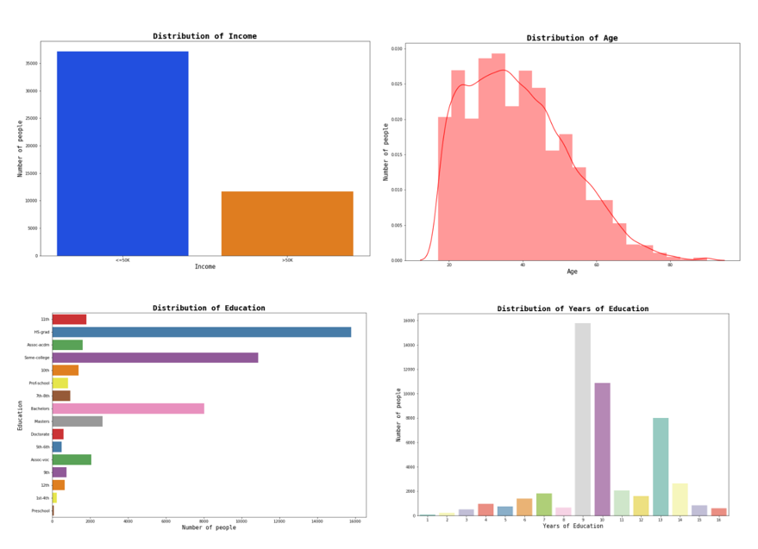
Univariate Analysis

Slide 9
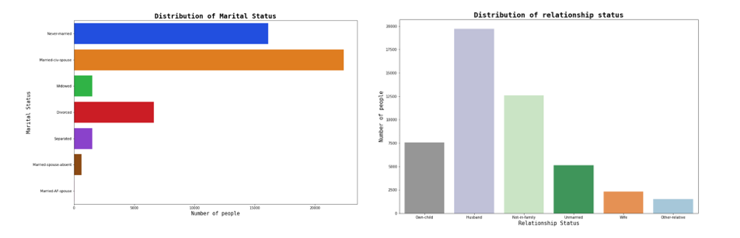

Slide 10
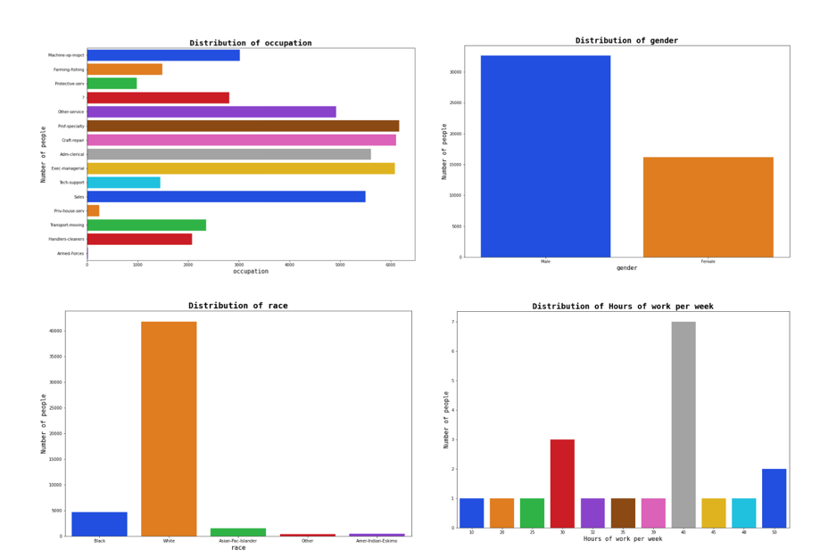

Slide 11
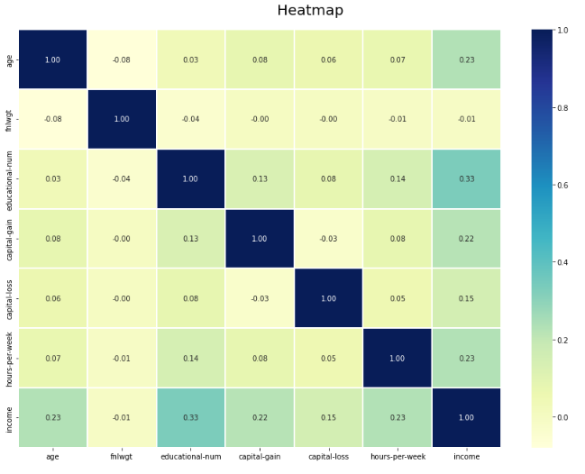
Data Assessment
The correlation matrix shows that income has high correlation with
educational-num
Age
Hours-per-week

Slide 12
Data Preprocessing
Fixing ‘?’ values in the dataset
By replacing them with most occurring value
Feature Selecting
Dropped feature: ‘fnlwgt’ and ‘capital-loss’
Fixing Imbalance Dataset
We fixed this problem by oversampling technique

Slide 13
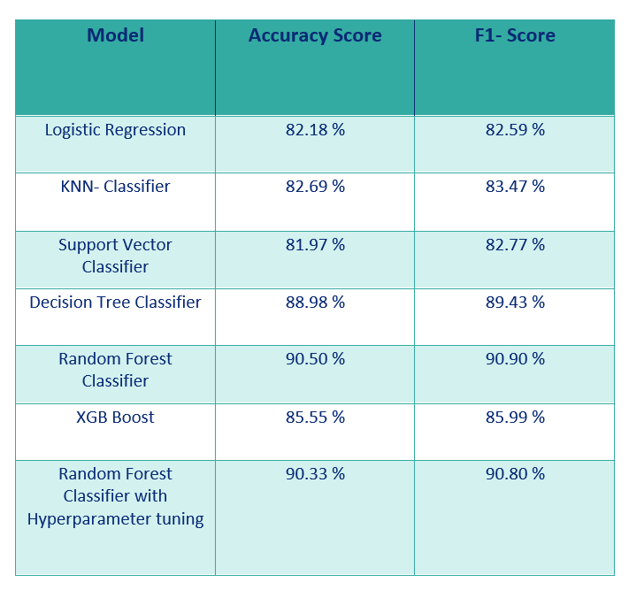
Data Modeling

Slide 14
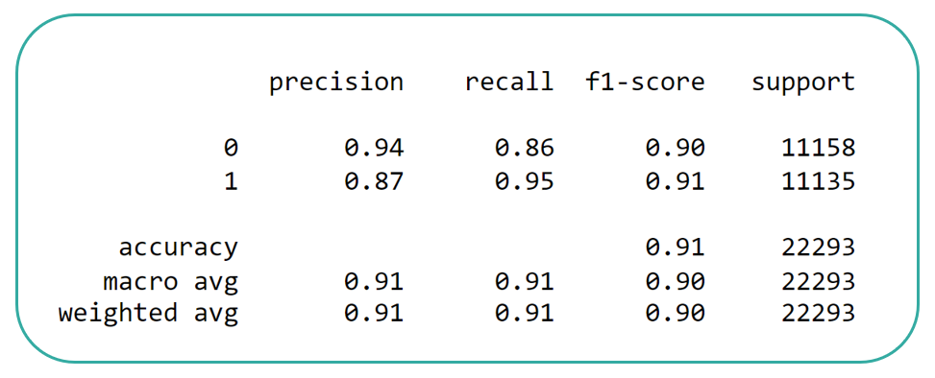
In this project, I build various models like logistic regression, KNN classifier, support vector classifier, decision tree classifier, random forest classifier and XGboost classifier.
A Random Forest Classifier (without hyper parameter tunned) gives the highest accuracy score of 90.50% and f1 score of 90.90%.

Slide 15

Thank You
rutvimgohel@gmail.com

